Slide 1

What makes people happier?
Adeline Silva Schäfer

Slide 2

About the Dataset
Survey of the state of global happiness including 156 countries
Includes data for years 2018 and 2019
Some countries were not present in both years

Slide 3

Data preparation
Data cleaning
Deleted unnamed columns
Removed Health life expectancy column (> 97% of NaNs)
Removed countries that only appear in one year
Handling NaNs
Since we only had one missing value for „Perception of Corruption“, I used the same value both years
Data Transformation
Renamed some countries, to match standards
Add column „Continents“, to be be able to identify regional trends
Data from Kaggle (https://www.kaggle.com/datasets/hserdaraltan/countries-by-continent)

Slide 4
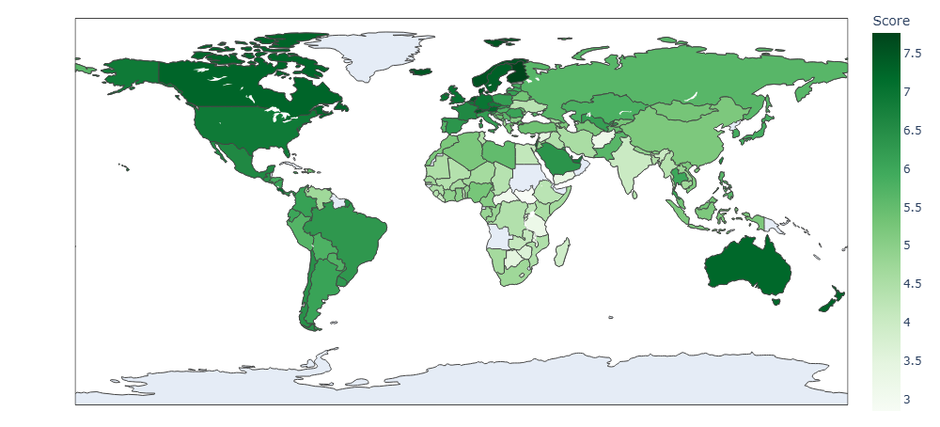
Happiness score over countries

Slide 5
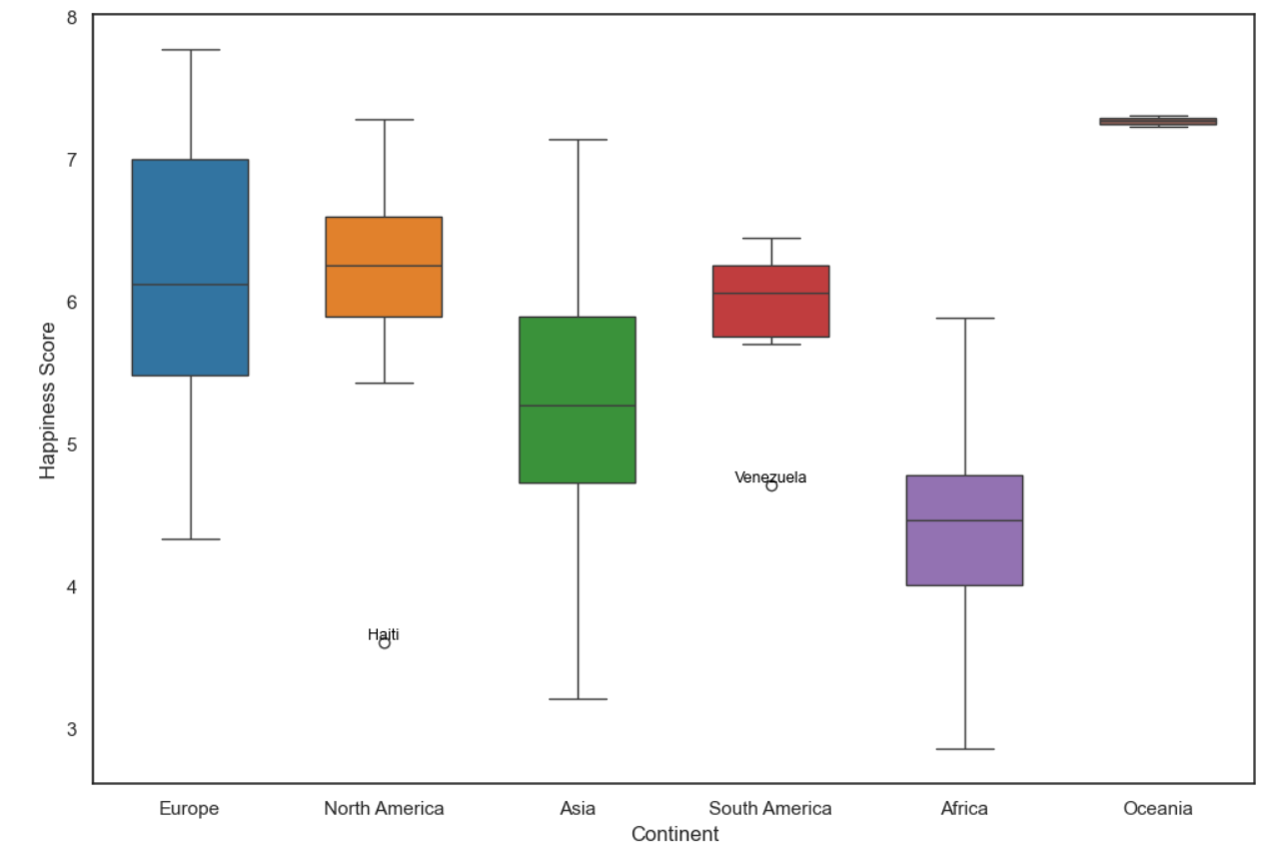
Happiness score x continents

Slide 6

Is there a significant difference over the years?
"Dieses Foto" von Unbekannter Autor ist lizenziert gemäß CC BY-NC

Slide 7
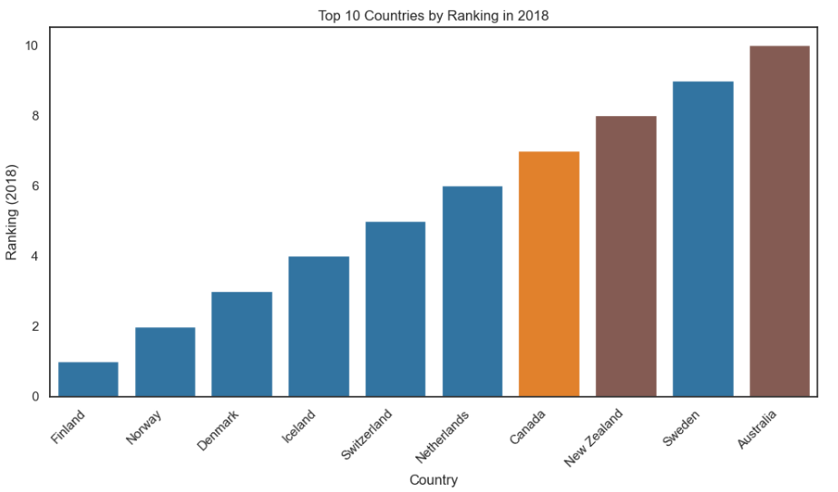
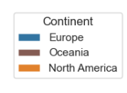
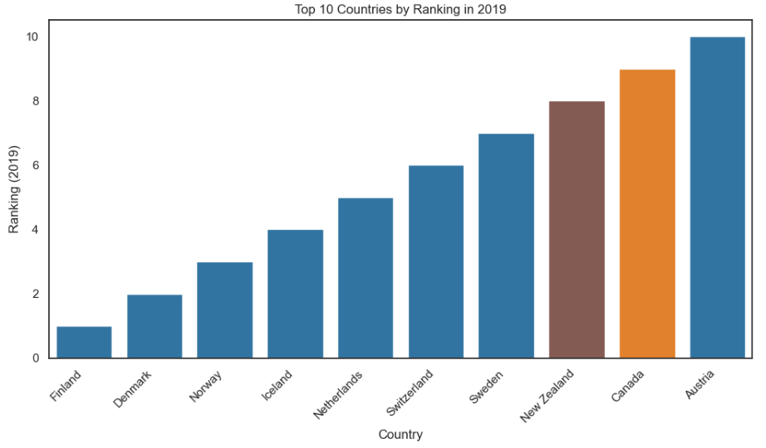
Top 10 countries

Slide 8
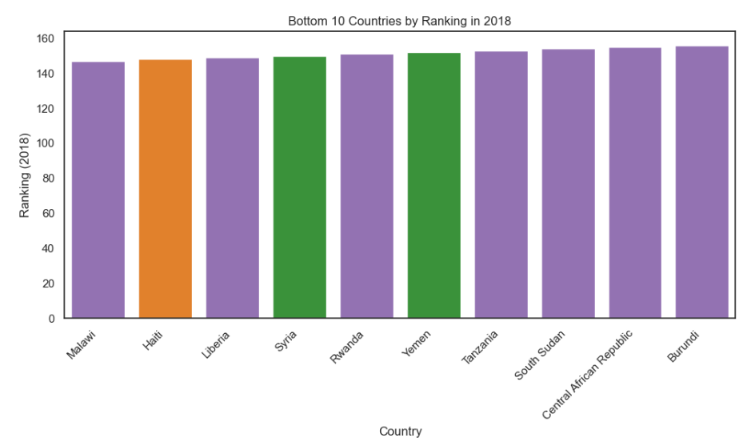
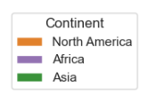
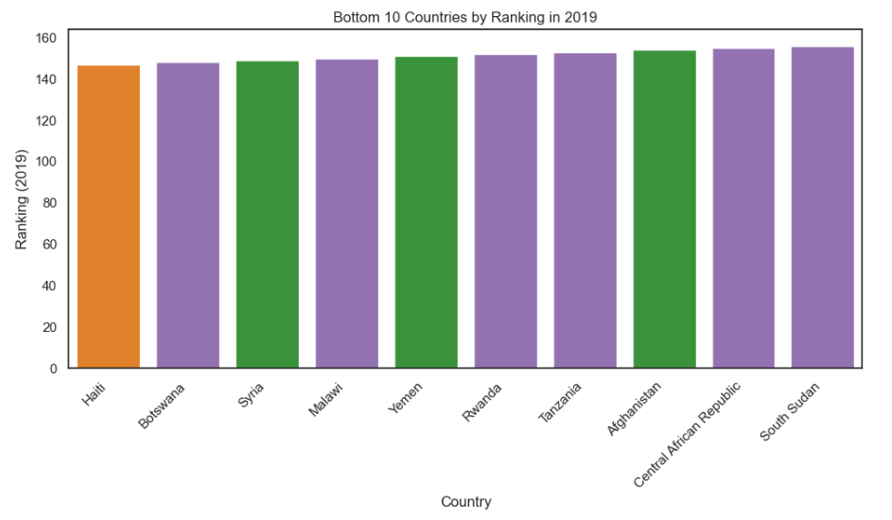
Bottom 10 countries

Slide 9
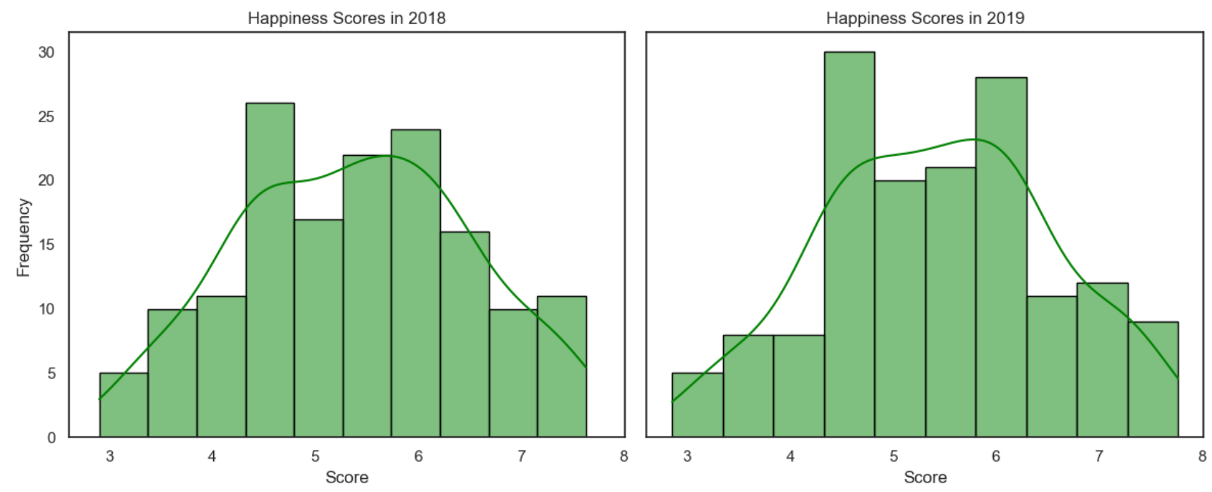
Happiness scores 2018 x 2019

Slide 10
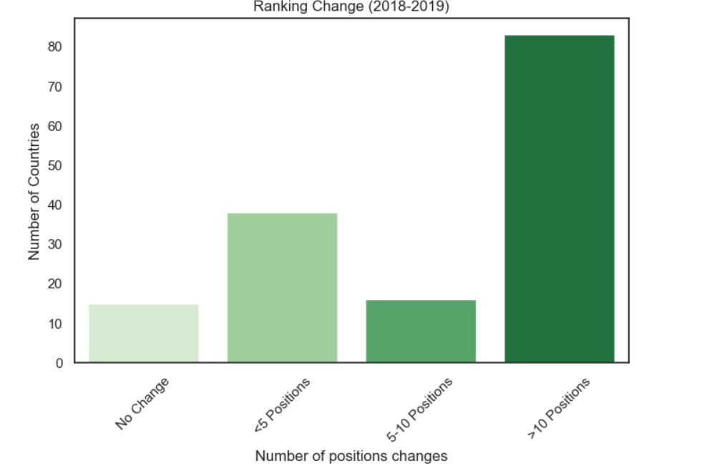
How many countries changed positions in raking?

Slide 11
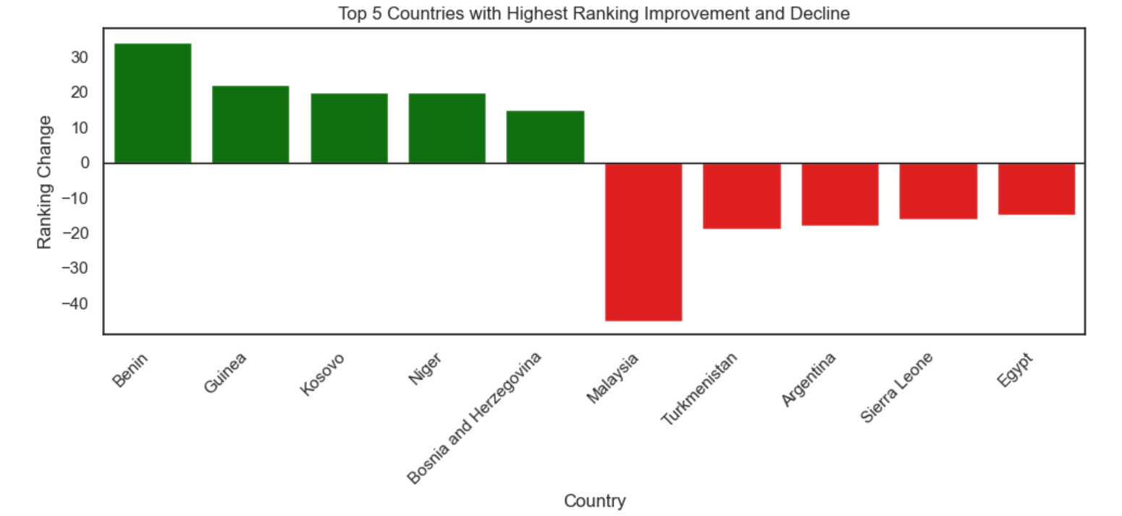
Main changes in the ranking
a
Notes:
economic conditions, governance challenges, and infrastructure limitations
Countries that experience a lot of political changes

Slide 12
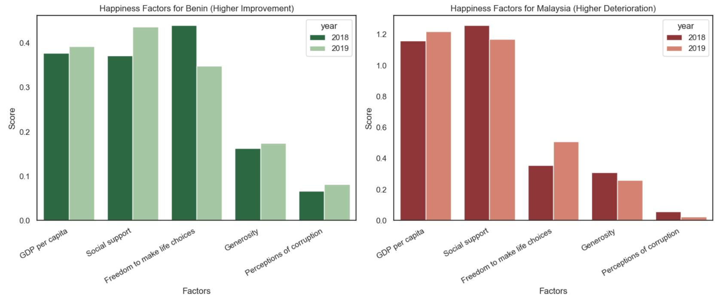



How these factors changed in the countries with the bigger changes in the ranking?

Slide 13
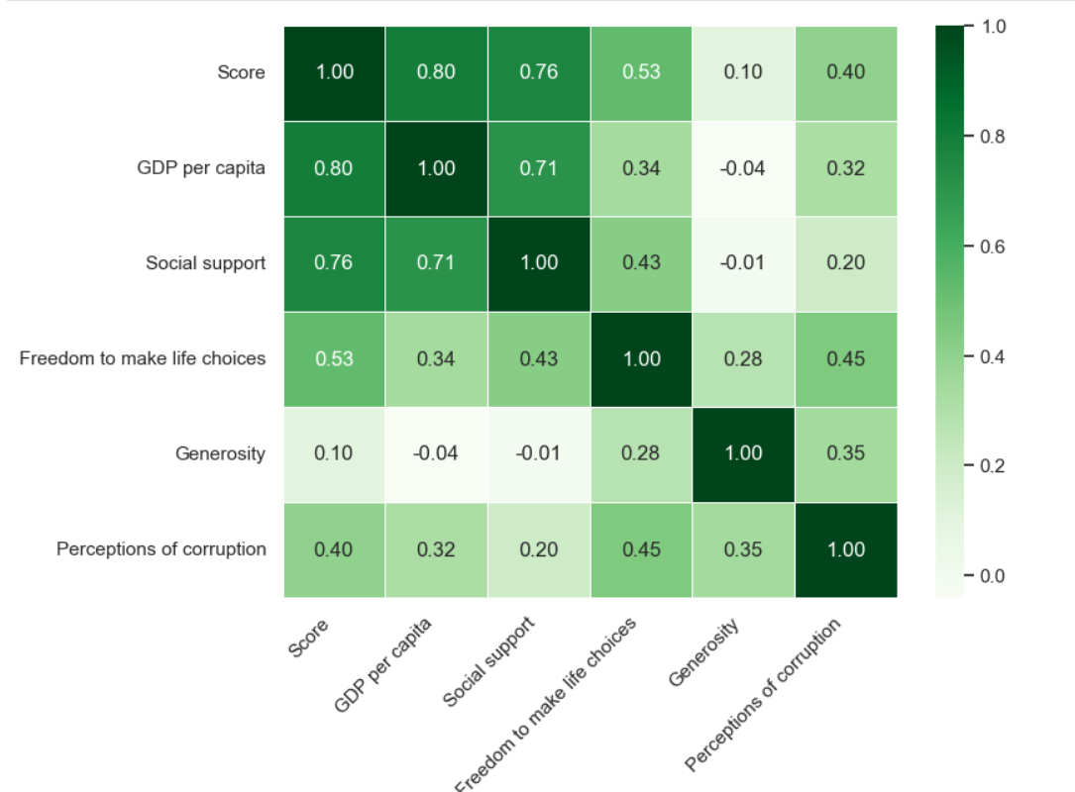


Which factors influence the score the most?

Slide 14
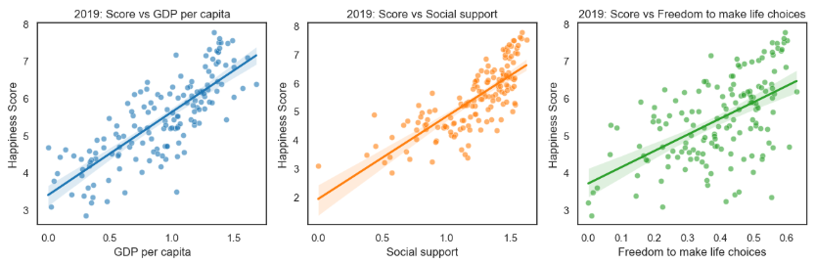
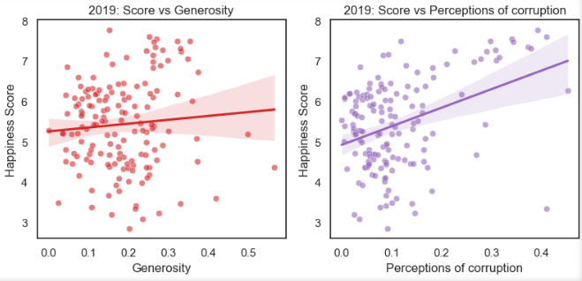
Scatterplots of the factors influencing the happiness score

Slide 15
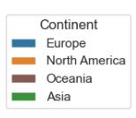

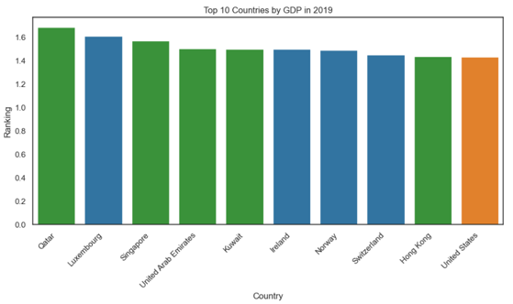
Top 10 countries x top 10 GDP per capita

Slide 16
Key Findings
No significant changes in happiness score but many changes in the ranking positions between 2018 and 2019
More changes in the bottom countries than in the top countries
The key factors contributing to happiness are GDP per capita and social support
However other factors influence the ranking. Among the top 10 countries, only 2 have the highest GDP per capita

Slide 17
Reflections
I expected life expectancy to play a role in the ranking, but unfortunately, this information was missing
It would have been much easier to define the questions before exploring the data
I would like to have explore how inequality plays a role on the happiness, but I didn’t have the time
It would have been interesting to analyze data over a longer time span. While there were many changes in the rankings, the overall values remained relatively stable

